Slide 1
Introduction to
Signcryption
November 22, 2004

Slide 2
Public Key (PK) Cryptography
Discovering Public Key (PK) cryptography has made the communication between people, who have never met before over an open and insecure network in a secure and authenticated way, possible!

Slide 3
Signature-Then-Encryption
Before sending a message out, the sender has to do the following:
  sign it using a Digital Signature (DS) scheme
  encrypt the message and the signature using a private key encryption algorithm under randomly chosen message encryption key
  encrypt the random message encryption key using the receiver’s public key
  send the message

Slide 4
Signature-Then-Encryption
Some Problems with This Approach:
  consumes machine cycles
  introduces “extended” bits to original messages
  requires a comparable amount of time for signature verification and decryption
  cost of delivering a message is essentially the sum of the cost for digital signature and that for encryption!

Slide 5

The Question is ….
Is it possible to send a message of arbitrary length with cost less than that required by signature-then-encryption?

Slide 6

Discovery
In 1997, Yuliang Zheng from Monash University in Australia has discovered a new cryptography primitive called “signcryption”.

Slide 7
What is Signcryption?
“Signcryption is a new paradigm in public key cryptography that simultaneously fulfills both the functions of digital signature and public key encryption in a logically single step, and with a cost significantly lower than that required by the traditional “signature and encryption” approach.”
Two Schemes
  Digital Signature
  Public Key encryption

Slide 8
Why Signcryption?
Based on discrete algorithm problem
  Signcryption costs 58% less in average computation time
  70% less in message expansion
Using RSA cryptosystem
  Signcryption costs on average 50% less in computation time
  91% less in message expansion

Slide 9
Signcryption–Implementation
Can be implemented using:
  ElGamal’s Shortened Digital Signature Scheme
  Schnorr’s Signature Scheme
  Any other digital signature schemes in conjunction with a public key encryption scheme like DES & 3DES
This choice would be made based on the level of security desired by the users.

Slide 10
Signcryption – Implementation
Using ElGamal’s Shortened Digital Signature Scheme (SDSS)

Slide 11
SDSS
Proposed by ElGamal
  enables one person to send a digitally signed message to another person
  the receiver can verify the authenticity of this message
  uses the private key of the sender to sign the message
  the receiver uses the sender’s public key to verify the signature

Slide 12
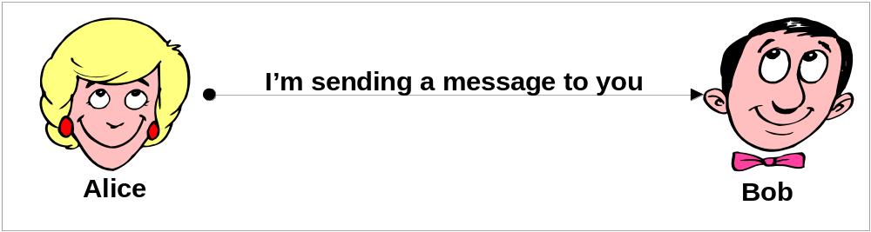
SDSS
Proposed by ElGamal
How it is implemented!

Slide 13
SDSS - Proposed by ElGamal
How It is Implemented
The variables involved are:
  m – the message
  p – a large prime number
  q – a large prime factor of p [1,…,p-1]
  g - an integer with order q modulo p [1,..,p-1]
  x – a number chosen uniformly at random from the range 1,…,q-1
  x_{a} – Alice’s private key chosen randomly from the range 1,..,q-1
  y_{a} – Alice’s public key y_{a} = gx_{a} mod p

Slide 14
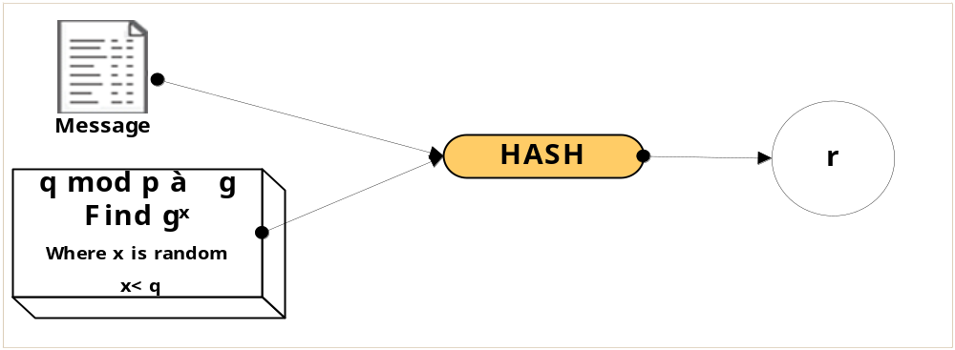
SDSS - Proposed by ElGamal
How It is Implemented ... Continued
Alice computes the component r by applying a hash function on the message m

Slide 15
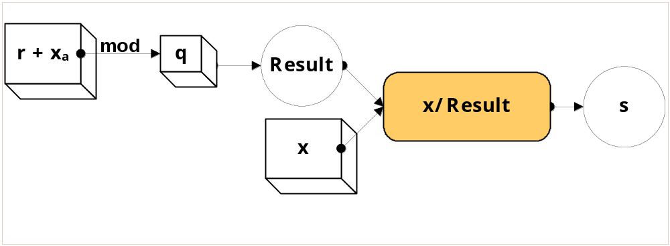
SDSS - Proposed by ElGamal
How It is Implemented ... Continued
She computes the component s, using her private key

Slide 16
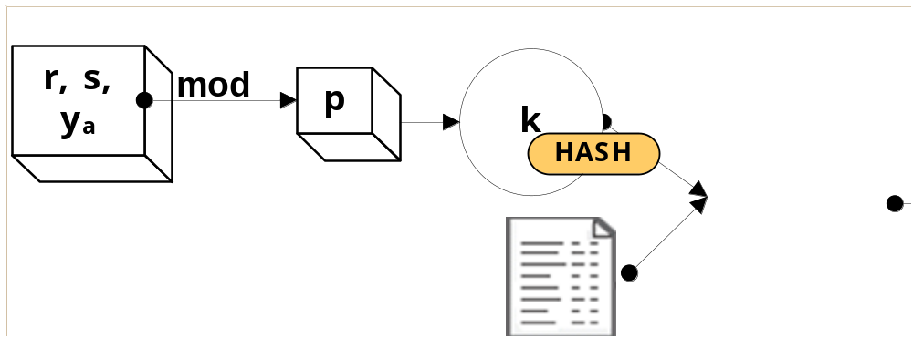
SDSS - Proposed by ElGamal
How It is Implemented ... Continued
The two components r and s are sent to Bob along with the message m
In receiving r and s, Bob uses r, s and Alice’s public key to obtain the value k
He applies a hash of the message using k and verifies that it is equal to r

Slide 17
SDSS - Proposed by ElGamal
How It is Implemented ... Continued
Bob accepts the message only if the hash of m and k gives him the same message m that he has received from Alice
This will ensure that Alice has digitally signed the message

Slide 18
Public Key Encryption
ciphertext = encrypt( plaintext, PK )
plaintext = decrypt( ciphertext, PK⁻¹ )
PK is the public key
PK⁻¹ is the private key

Slide 19
Signcryption – How It Works
  Using ElGamal’s SDSS and a public key encryption

Slide 20
Signcryption – How It Works
Parameters for Signcryption
Parameters public to all | p – a large prime number q – a large prime factor of p-1 g – an integer with order q modulo p chosen randomly from [1,…,p-1] Hash – a one-way hash function whose output has, say, at least 128 bits KH – a keyed one-way hash function (E, D) – the encryption and decryption algorithms of a private key cipher
Alice’s keys | x_{a} – Alice’s private key, chosen uniformly at random from [1,…,q-1] y_{a} – Alice’s public key (y_{a} = g^{x}_{a} mod p)
Bob’s keys | x_{b} – Bob’s private key, chosen uniformly at random from [1,…,q-1] y_{b} – Bob’s public key (y_{b} = g^{x}_{b} mod p)

Slide 21

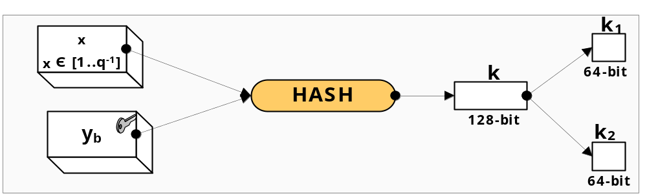
Signcryption – How It Works
Steps to Signcrypt Messages
    chooses a value x from the large range 1,…,q-1
    uses Bob’s public key and the value x, and computes the hash of it → It gives her a 128 bit string
    splits this 128-bit value k into two 64-bit halves (k₁,k₂) →(key pair)

Slide 22
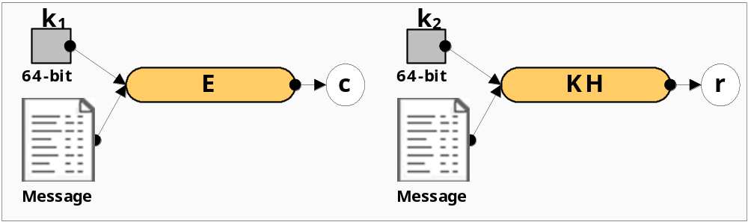
Signcryption – How It Works
Steps to Signcrypt Messages ...(Continued)
    encrypts the message m using a public key encryption scheme E with the key k₁→ the cipher text c
    c = Ek₁(m)
    uses the key k₂ in the one-way keyed hash function KH to get a hash of the message m →128-bit called r
    r = KHk₂(m)

Slide 23
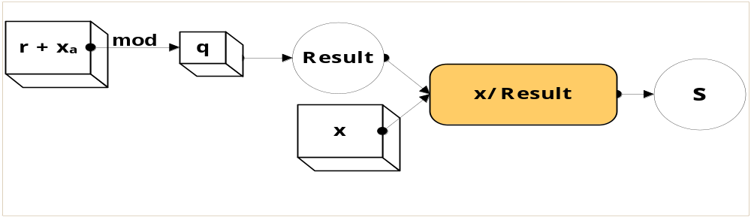
Signcryption – How It Works
Steps to Signcrypt Messages ...(Continued)
    computes the value of s - like in SDSS
  She does this using:
      the value of x
      her private key x_{a}
      the value of r
s = x/ (r + x_{a}) mod q

Slide 24
Signcryption – How It Works
Steps to Signcrypt Messages ...(Continued)
    Now Alice has three different values (c, r and s)
    She has to send these three values to Bob to complete the transaction
    She can do this in a couple of ways:
      send them all at one time
      send them separately using secure transmission channels, which would increase security
  NOW, the message is Signcrypted!

Slide 25
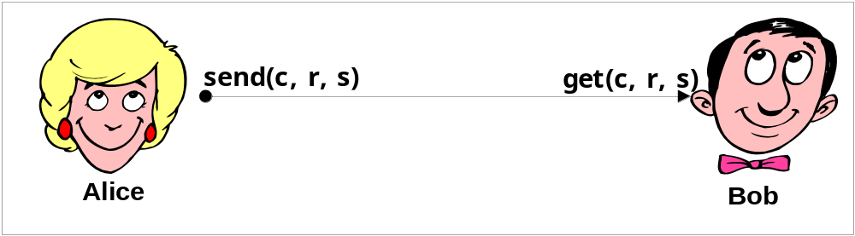
Signcryption – How It Works
Steps to Signcrypt Messages ...(Continued)

Slide 26

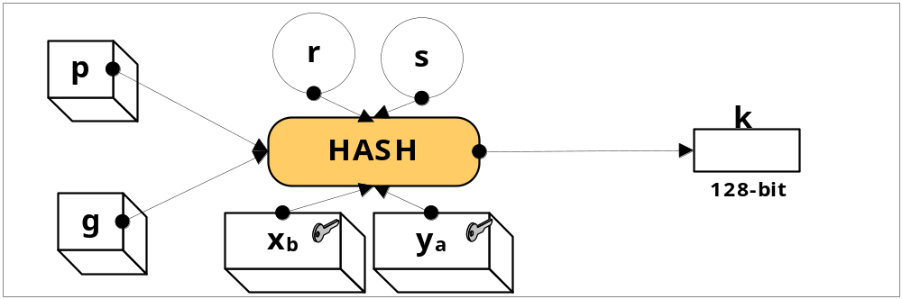
Signcryption – How It Works
Steps to Unsigncrypt Messages
    receives the 3 values that Alice has sent to him (c, r, s)
    to compute a hash, he uses the values of r and s, his private key x_{b}, Alice’s public key y_{a} & p and g
    This would give him 128-bit result
    k = hash((ya * gr)s*x_{b} mod p)

Slide 27
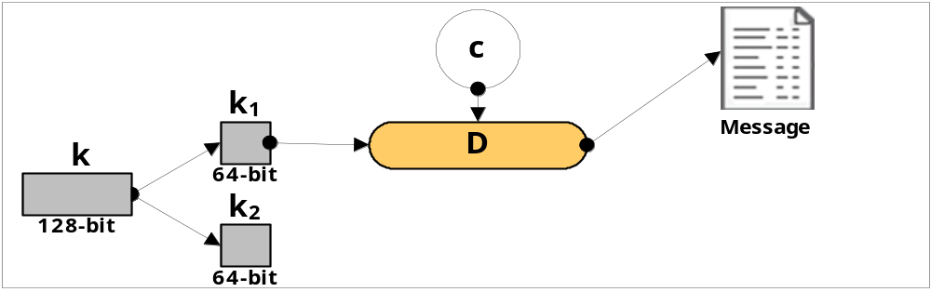
Signcryption – How It Works
Steps to Unsigncrypt Messages ...(Continued)
    This 128-bit hash result is split into two 64-bit halves (k₁,k₂) →(key pair)
    This key pair would be identical to the key pair that was generated while signcrypting the message
    Bob uses the key k₁ to decrypt the cipher text c, which will give him the message m
    m = Dk₁(c)

Slide 28
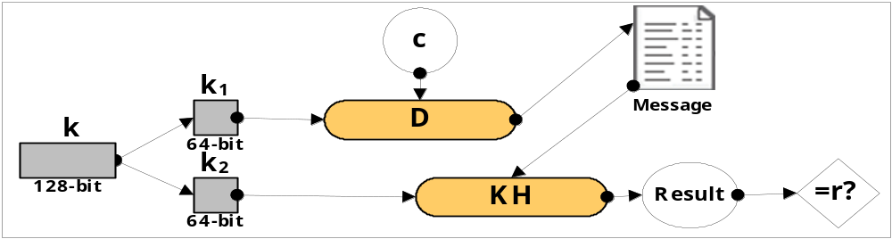
Signcryption – How It Works
Steps to Unsigncrypt Messages ...(Continued)
    Bob does a one-way keyed hash function (KH) on m using the key k₂ and compares the result with the value r he has received from Alice
    If match → the message m was signed and sent by Alice
    If not match → the message wasn't signed by Alice or was intercepted and modified by an intruder
    Bob accepts the message m if and only if KHk₂(m) = r

Slide 29
Features of Digital Signcryption
Unique Unsigncryptability
  message m of arbitrary length is Signcrypted using Signcryption algorithm
  This gives you a Signcrypted output c
  The receiver can apply Unsigncryption algorithm on c to verify the message m
  This Unsigncryption is unique to the message m and the sender

Slide 30
Features of Digital Signcryption
Security
  Two security schemes
    Digital Signature
    Public Key encryption
    likely to be more secure
  ensures that the message sent couldn’t be forged
  ensures the contents of the message are confidential
  ensures non-repudiation

Slide 31
Features of Digital Signcryption
Efficiency
  Computation involved when applying the Signcryption, Unsigncryption algorithms and communication overhead is much smaller than signature-then-encryption schemes

Slide 32
Signcryption Security

Slide 33
Signcryption Security
Unforgeability:
  Bob is in the best position to be able to forge any Signcrypted message from Alice!
  Bob can only obtain the message m by decrypting it using his private key X_{b}
  Any changes he makes to the message m will reflect in the next step of Signcryption
  one-way keyed hash function on the message m will not match the value r!
  Bob, the prime candidate for this kind of attack, is prevented from forging Alice’s Signcrypted message

Slide 34
Signcryption Security
Confidentiality:
  An attacker has all three components of the Signcrypted message: c, r and s!
  He still can not get any partial information of the message m!
  The attacker have to also know Bob’s private key, p and q (known only to Alice and Bob)
  Bad luck Attacker!!

Slide 35
Possible Applications of Signcryption

Slide 36
Possible Applications of Signcryption
Signcryption in WTLS Handshake Protocol
  Existing security is by Signature-then-Encryption or Encryption-then-Signature
  User certificate is sent without encryption or another cryptographic method
  Modified Signcryption is proposed as a solution

Slide 37
Possible Applications of Signcryption
Unforgeable Key establishment over ATM Network
  Transmitting encrypted keys over an ATM network is critical
  Existing security relies on key distribution system
  Modified Signcryption can solve the problem

Slide 38
Advantages and Disadvantages

Slide 39
Advantages of Signcryption
Low computational cost
  If one person is sending a signcrypted message to another, computational costs doesn’t matter much
  If signcryption of entire network traffic is considered, then computational power as well as savings in bandwidth are major factors

Slide 40
Advantages of Signcryption
Higher Security
  “If two security schemes are brought together would it increase or decrease the security?”

Slide 41
Advantages of Signcryption
Higher Security
  When two security schemes are combined, which by themselves are complex enough to withstand attacks, it can only lead to added security

Slide 42
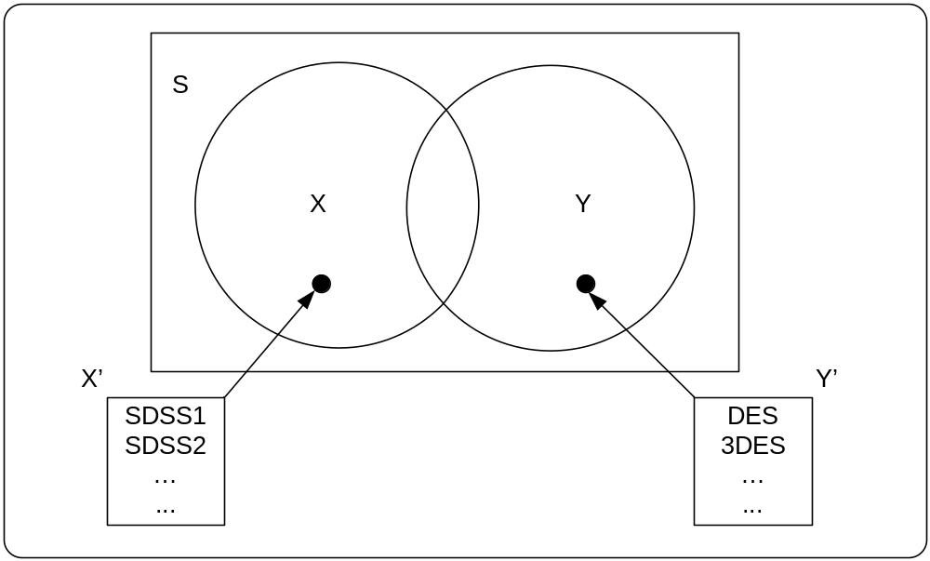
Advantages of Signcryption
Higher Security
X’ = {SDSS1,SDSS2,……}
Y’ = {DES, 3DES, …..}

Slide 43
Advantages of Signcryption
Message Recovery
  To recover a message E-mail system of Alice must do one of the following:
    keeps a copy of the signed and encrypted message as evidence of transmission
    In addition to the above copy, keep a copy of the original message, either in clear or encrypted form

Slide 44
Advantages of Signcryption
Message Recovery
  A cryptographic algorithm or protocol is said to provide a past recovery ability if Alice can recover the message from the signed and encrypted message using only her private key
  While both Signcryption and “signature-then-encryption-with-a-static-key" provide past recovery but “signature-then-encryption" does not

Slide 45
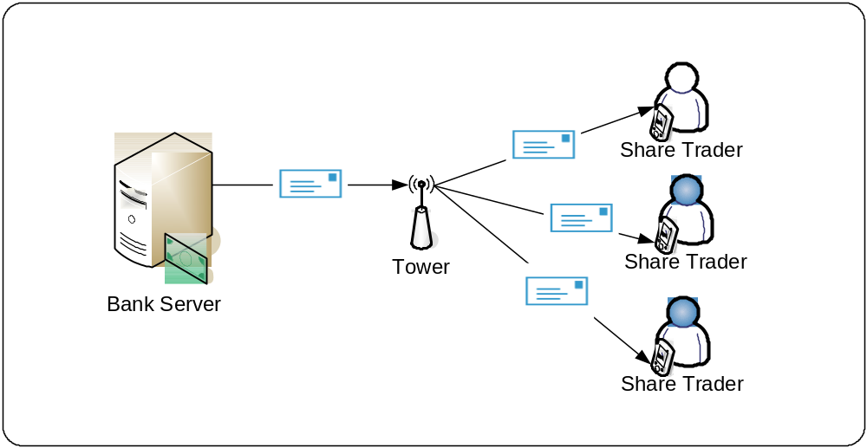
Disadvantages of Signcryption

Slide 46
Disadvantages of Signcryption
In broadcasting a single Signcrypted message to multiple recipients
This approach is redundant in terms of bandwidth consumption and computational resource usage

Slide 47
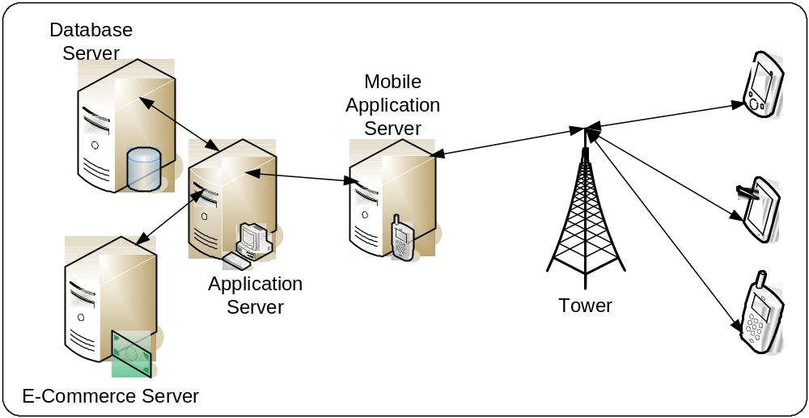
Future Scenario of Signcryption

Slide 48
Conclusion…
Two birds in one stone
Combining two complex mathematical functions, you will increase the complexity and in turn increase security
Signcryption still has a long way to go before it can be implement effectively
Research is still going on to try to come up with a much more effective way of implementing this

Slide 49


